Slide 1
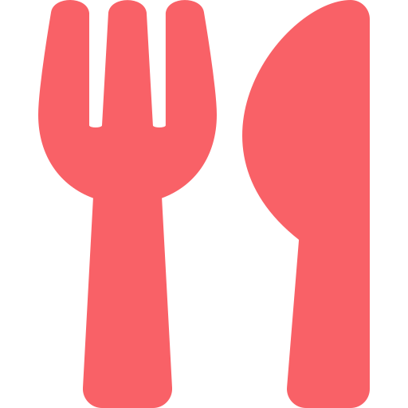
FOOD ORDERING ANALYTICS
Food Ordering Trends
& Customer Insight
A Power BI Dashboard Deep-Dive on Ordering Behavior, Delivery Performance & Customer Loyalty
Prepared from: Food Ordering Distribution Dashboard | Report Date: July 2026
Notes:
Opening slide. Introduce the report as an analysis of the Power BI food ordering dashboard covering revenue, order patterns, delivery performance, and customer behavior.

Slide 2




Executive Summary
A snapshot of overall platform performance across all cities, hunger levels, and companies.
TOTAL REVENUE
TOTAL ORDERS
AVERAGE RATING
AVG. DELIVERY FEE
₹27.39M
50K
2.99 / 5
₹59.64
Gross revenue across all orders
Orders placed platform-wide
Customer satisfaction score
Mean fee charged per order
Key Takeaways
Orders are split almost evenly across Breakfast, Lunch, Dinner, and Snacks — no single meal occasion dominates demand.
Premium, Mid-range, and Budget restaurants each contribute roughly a third of total order volume.
Half of all customers (50%) are repeat orderers, indicating solid — but improvable — platform loyalty.
Average customer rating sits at 2.99/5, signaling meaningful room to improve service quality and satisfaction.
Notes:
Set the stage with headline KPIs, then move into four key narrative takeaways that will be expanded in later slides.

Slide 3


Ordering Patterns
When customers order, and what they order it for.
Order Activity by Time of Day
Orders by Meal Type
Order activity peaks in the morning and gradually tapers through the day, dipping to its lowest point in the afternoon.
Demand is remarkably balanced: Breakfast, Dinner, Snacks, and Lunch each represent roughly a quarter of all orders — a truly all-day platform.
Notes:
Time-of-day trend shows morning peak with gradual decline. Meal type split is nearly even across all four occasions.

Slide 4

Restaurant & Cuisine Mix
Where the revenue comes from, by restaurant tier and cuisine type.
Restaurant Type Distribution
Revenue by Cuisine
Order volume is nearly split three ways — Premium (33.8%), Budget (33.4%), and Mid-range (32.8%) restaurants each pull an equal share.
Revenue is evenly distributed across all six major cuisines, with North Indian and Biryani slightly ahead of Desserts and Fast Food.
Notes:
Restaurant tier split is essentially equal thirds. Cuisine revenue is broad-based rather than concentrated in one category.

Slide 5

Delivery Performance & Loyalty
How fast orders arrive, and how often customers come back.
Total Orders by Delivery Speed
Repeat Order Rate
50%
of customers place
repeat orders
Exactly half of the customer base returns for another order — a strong loyalty foundation with clear room to grow through targeted retention offers.
Average-speed deliveries lead order volume (18K), closely followed by Fast (17K); Slow deliveries trail at 15K of total orders.
Notes:
Delivery speed distribution is fairly even with average/fast dominating. Repeat order rate stands at an even 50/50 split.

Slide 6


Customer Mood & Behavior
The emotional context behind every order.
Total Orders by Mood
What This Tells Us
Stress is the single biggest emotional driver of orders — comfort food and convenience clearly matter most under pressure.
Celebratory orders run a close second, suggesting the platform is a go-to choice for marking good moments.
"Lazy" orders, while lowest, still represent a meaningful ~12.2K of volume — a natural target for convenience-led promotions.
The narrow spread across moods (only ~3% variance top-to-bottom) shows the platform serves emotional needs consistently, not just one occasion.
Notes:
Mood-driven ordering is fairly balanced, with stress and celebration as the top two emotional triggers.

Slide 7
Recommendations
Four opportunities to grow revenue, ratings, and retention.
Lift the Rating Score
Grow Repeat Orders Beyond 50%
A 2.99/5 average signals a service-quality gap. Investigate low-rated orders by cuisine and restaurant tier to target fixes.
Launch loyalty perks and personalized re-order prompts for the 50% of customers who haven't returned yet.
Speed Up 'Slow' Deliveries
Lean into Mood-Based Marketing
Slow deliveries trail Average and Fast by ~3K orders — prioritize routing and staffing fixes in that segment.
Promote comfort-food bundles for 'Stressed' moments and celebratory add-ons for festive occasions.
Thank you | Source: Food Ordering Distribution Power BI Dashboard
Notes:
Close with four concrete, data-backed recommendations tied directly to the metrics shown earlier in the deck.

